Slide 1
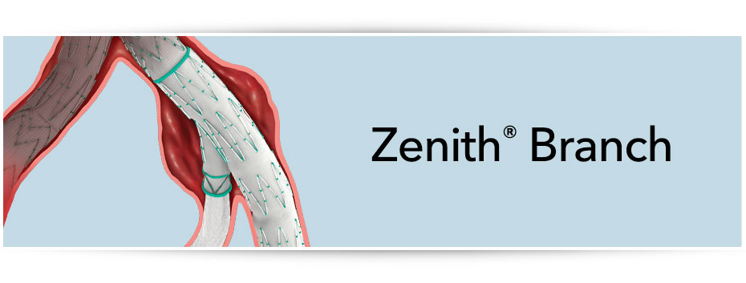
Zenith Branch Iliac Endovascular Graft
05/03/2021

Slide 2
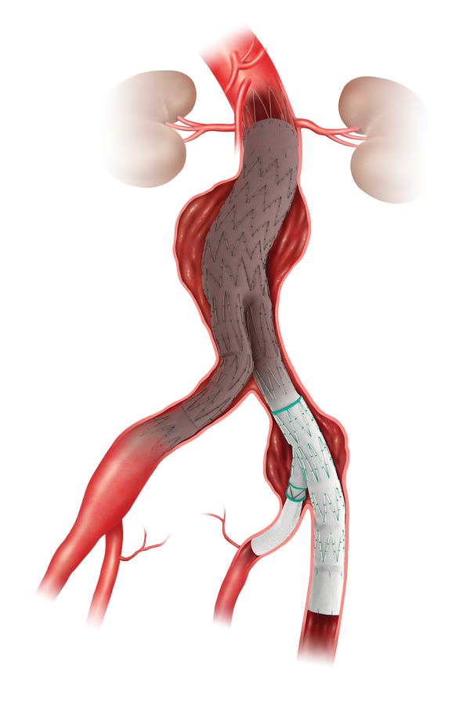
Preservation Therapy
Up to 40% of abdominal aortic aneurysms have coexisting unilateral or bilateral iliac artery ectasia or aneurysm.
Iliac Artery Occlusion Leads to Increased Risk of Buttock and Thigh Claudication.
Up to 1 in 3 patients with bilateral internal iliac occlusion experience buttock and/or thigh claudication.*
*Bradby MJ, Munneke GM, Belli AM, Loosemore TM, Loftus I, Thompson MM, Morgan RA.
How Safe is Bilateral Internal Iliac Artery Embolization Prior to EVAR? Cardiovasc Intervent Radiol (2008) 31:246-253.

Slide 3
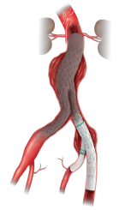
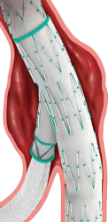
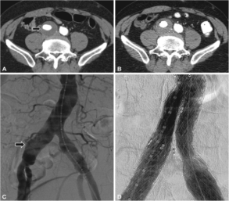
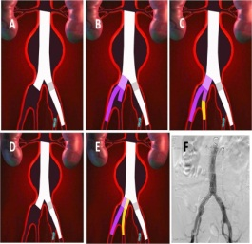
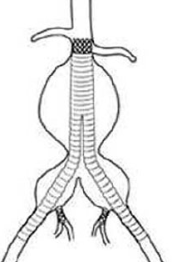
Common Iliac Artery Aneurysm
Including an Internal Artery Aneurysm
Excluding an Internal Artery Aneurysm
Surgical
Embolization + extension in EIA
Endovascular
Iliac Branch Device
Bell-bottom technique
Chimney / Sandwich
Coil or ligate the IIA and extend to EIA
Surgical

Slide 4
Zenith Branch Iliac System
The Technology
The Zenith Iliac Branch Endovascular Graft has over 15 years practical experience and is the first endovascular graft specifically designed to preserve flow to the internal iliac artery, helping to reduce the potential for a ischemic sequelae.
The device builds on the proven features of the Zenith technology by incorporating:
Off-the-shelf stent graft
Modular in design
Precise and simple deployment (Hydrophilic Flexor Sheath & Pre-loaded, curved catheter)
A solution for up to 40% of patients
Over 10 years of clinical evidence

Slide 5
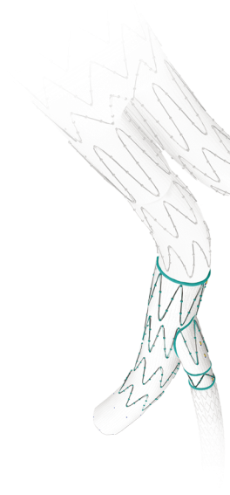
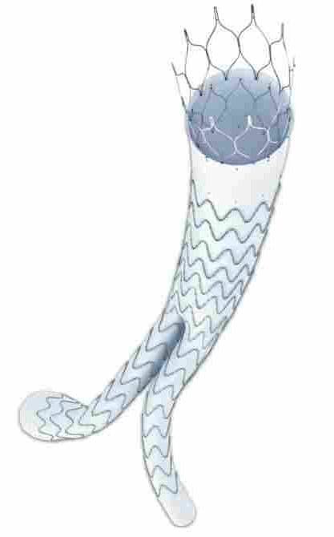
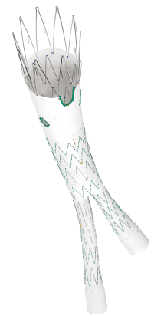
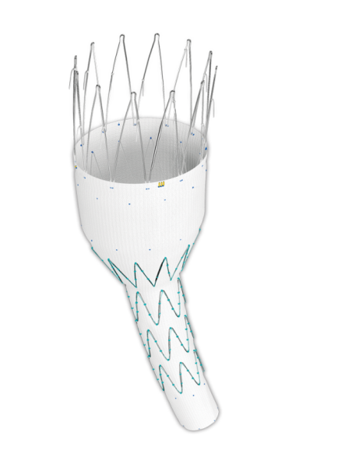
Device Modularity
Works with the full Zenith portfolio:
Preservation of internal iliac arteries (ZBIS)
AAA Repair (Zenith Alpha)
Treatment of short necks (Zenith Fenestrated)
Repair of failed grafts (Zenith Renu)

Slide 6
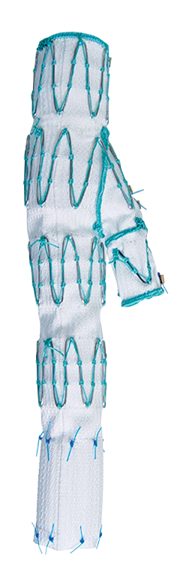
Device Overview
Ø 12 mm
Common iliac segment
Length 45 mm or 61 mm
Side-branch segment
Overlap 10 mm - 14 mm
Ø 8 mm
External iliac segment
Length 41 mm or 58 mm
Ø 10 mm or 12 mm

Slide 7
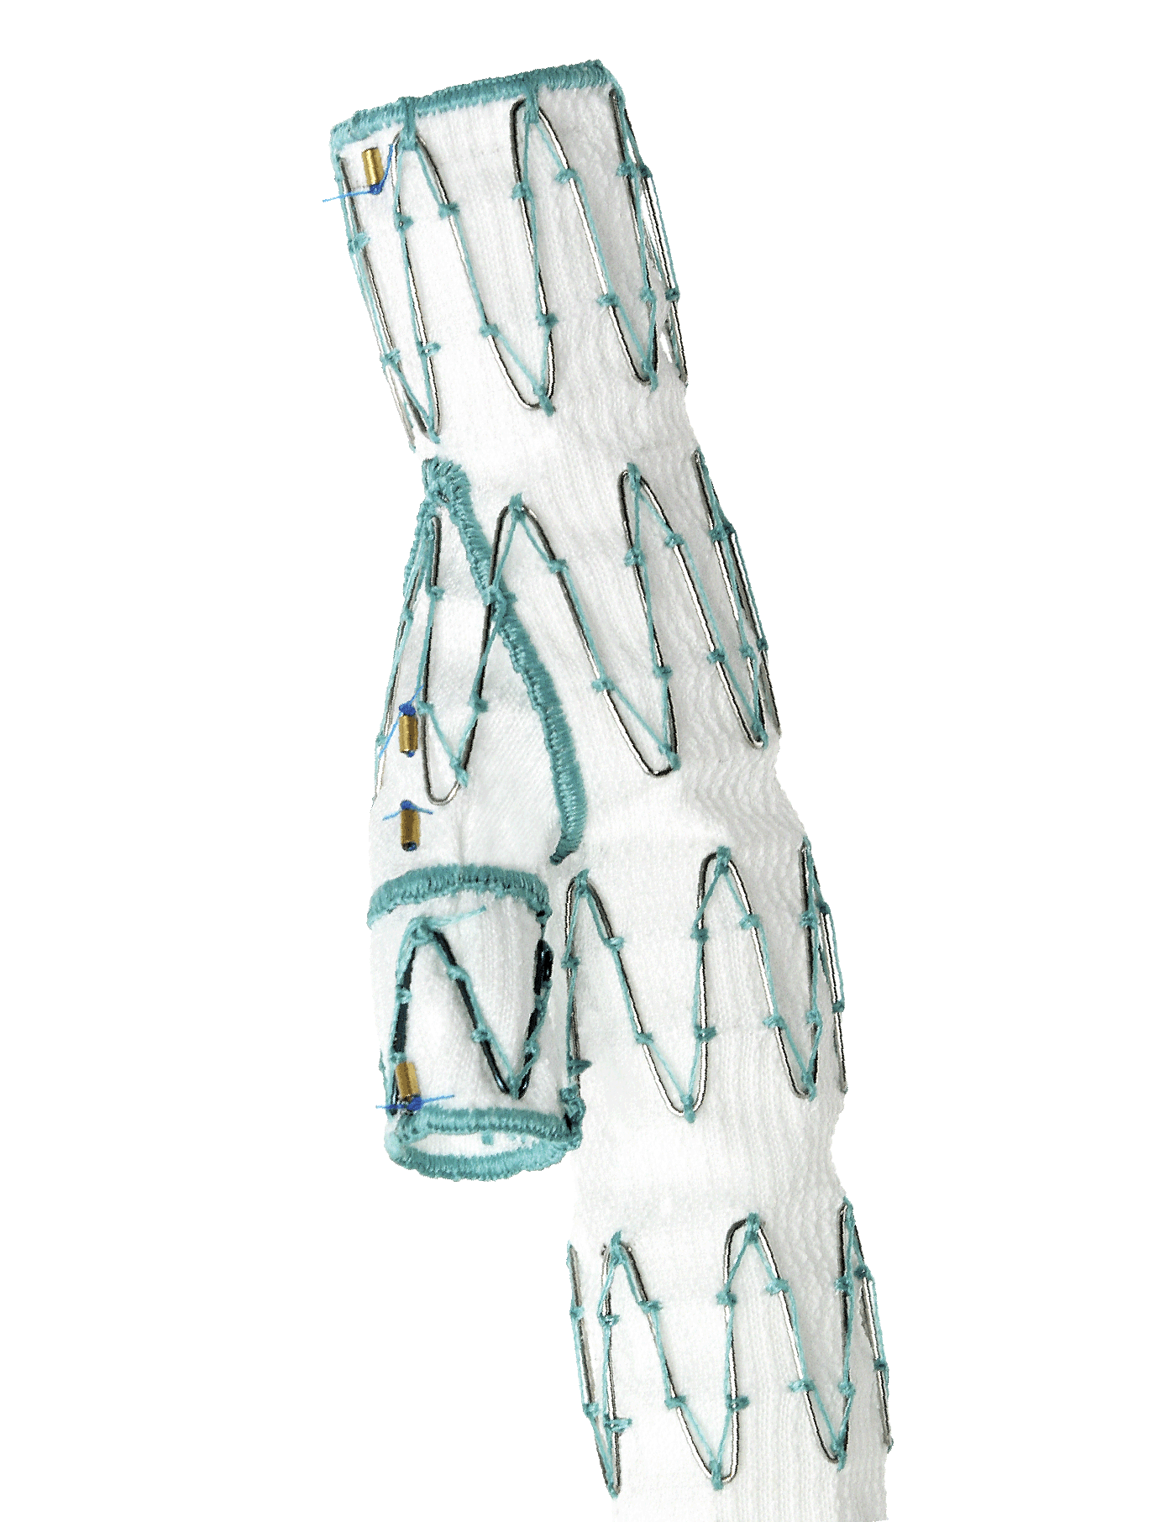
Device Design Attributes
Cook Z-stent design helps secure and seal bridging stent
Radiopaque gold markers help with precise positioning
Sealing Rings
Nitinol sealing rings help secure bridging stent and maintain lumen patency during access
Cook-Z Stent

Slide 8
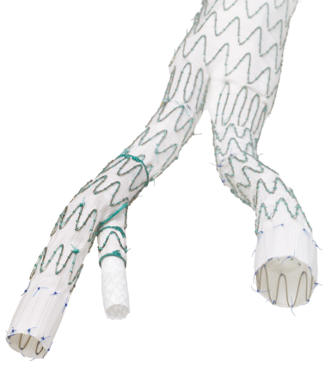
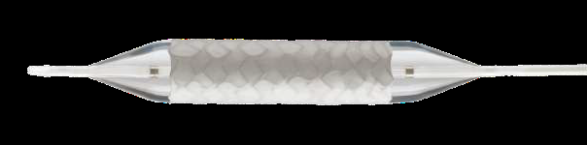
Device Configuration
Zenith Alpha AAA Endovascular Stent Graft
Bridging Stent:
ZISL Leg 16 mm diameter
Zenith Branch Iliac Device
Balloon expandable covered stent

Slide 9
Indications for use
Indicated for the endovascular treatment of patients with an aortoiliac or iliac aneurysm, an insufficient distal sealing site within the common iliac artery, and having morphology suitable for endovascular repair, including:
Adequate iliac/femoral access compatible with a 20 French (7.7mm O.D.) introduction system
Non-aneurysmal external iliac artery fixation segment distal to the aneurysm:
With a length of at least 20 mm
With a diameter measured outer wall to outer wall of no greater than 11mm and no less than 8 mm
Non-aneurysmal internal iliac artery segment distal to the aneurysm:
With a length of at least 10 mm (with 20-30 mm being preferred)
With a diameter acceptable for proper sealing

Slide 10
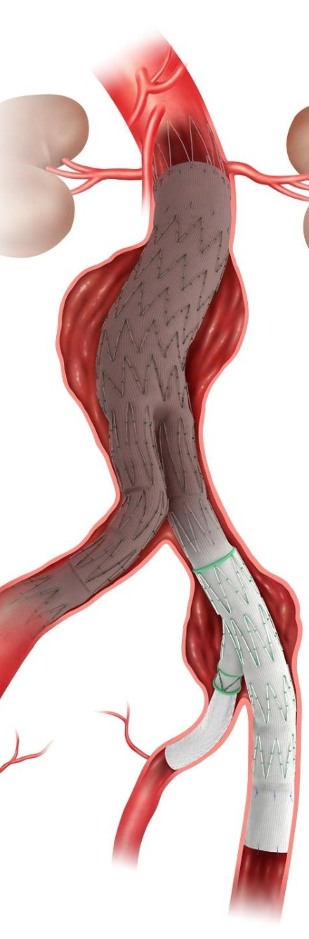
What do we know about the Cook Medical Zenith® Branch Iliac Endovascular System?

Slide 11
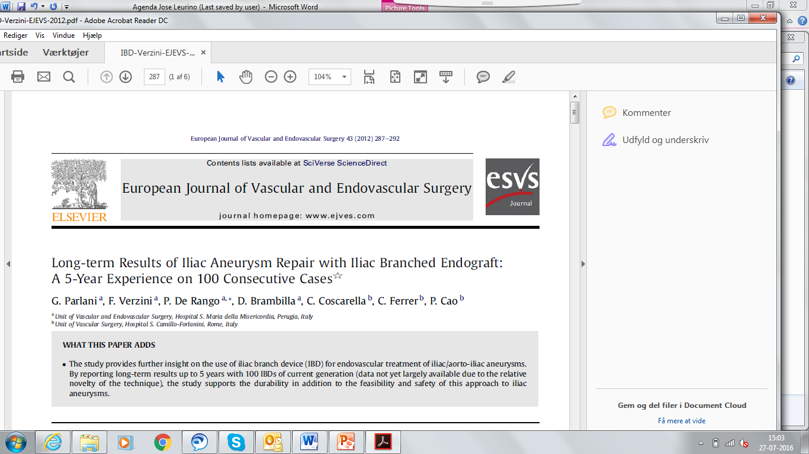
(Eur J Vasc Endovasc Surg. 2012; 43; 287:292)
Disease-specific treatment option for common iliac aneurysm
0% ruptures – No ruptures
A low 5% technical failure
Only 2% endoleak rate

Slide 12
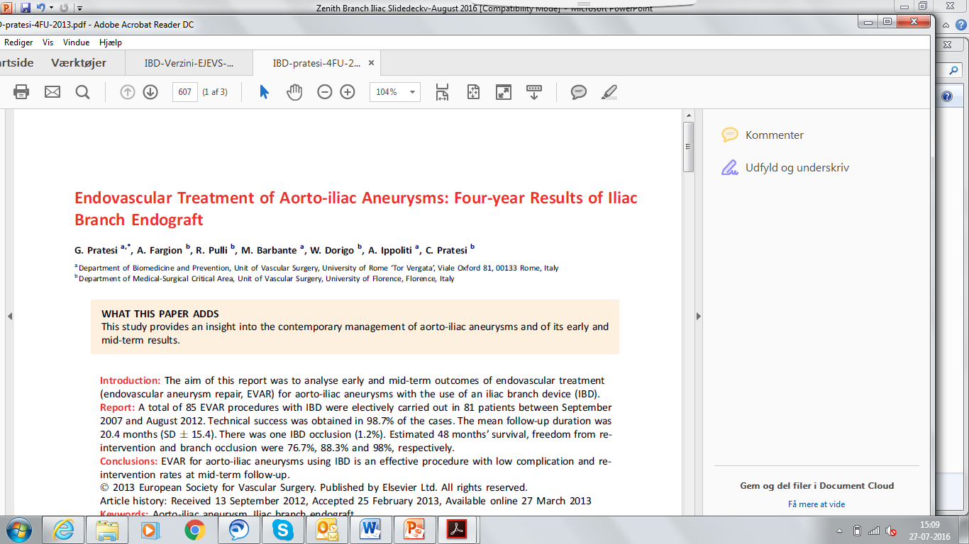
(Eur J Vasc Endovasc Surg.2013; 45; 607:609)
Early and mid-term outcomes of endovascular treatment for aorti-iliac aneurysm using IBD
85 procedures in 81 patients
Mean FU 20.4 months
Technical success 98.7%
Freedom from branch occlusion 98%

Slide 13
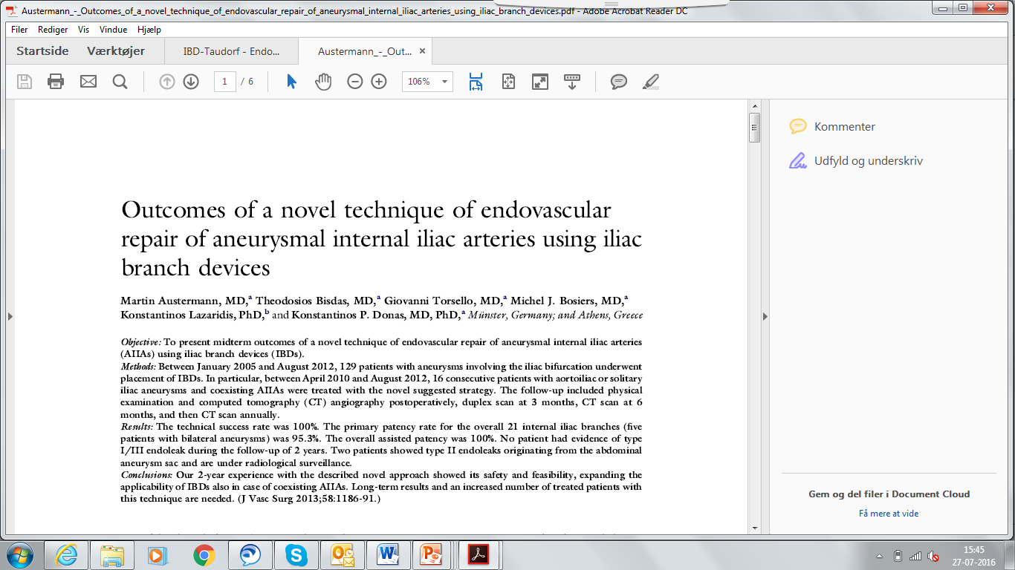
(J Vasc Surg 2013;58:1186-91)
Conclusions: Our 2-year experience with the described novel approach showed its safety and feasibility, expanding the applicability of IBDs also in case of coexisting AIIAs.
n= 129
The technical success rate was 100%
The overall assisted patency was 100%
No patient suffered from buttock claudication or had evidence of type I/III endoleak during the follow-up of 2 years.

Slide 14
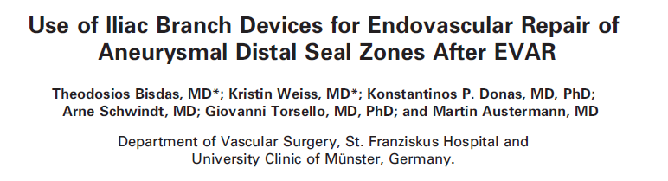
(J Endovasc Ther 2014;21:579–586)
Iliac side branch endografting showed excellent feasibility and encouraging midterm outcomes for the challenging endovascular repair of aneurysmal distal seal zones post EVAR.
From 188 pat, 18 patients were treated for aneurysm degeneration of 22 distal seal zone
Mean FU 15 months
Primary outcome: Technical success 100 %
No type Ib or III endoleks
2 device related interventions

Slide 15
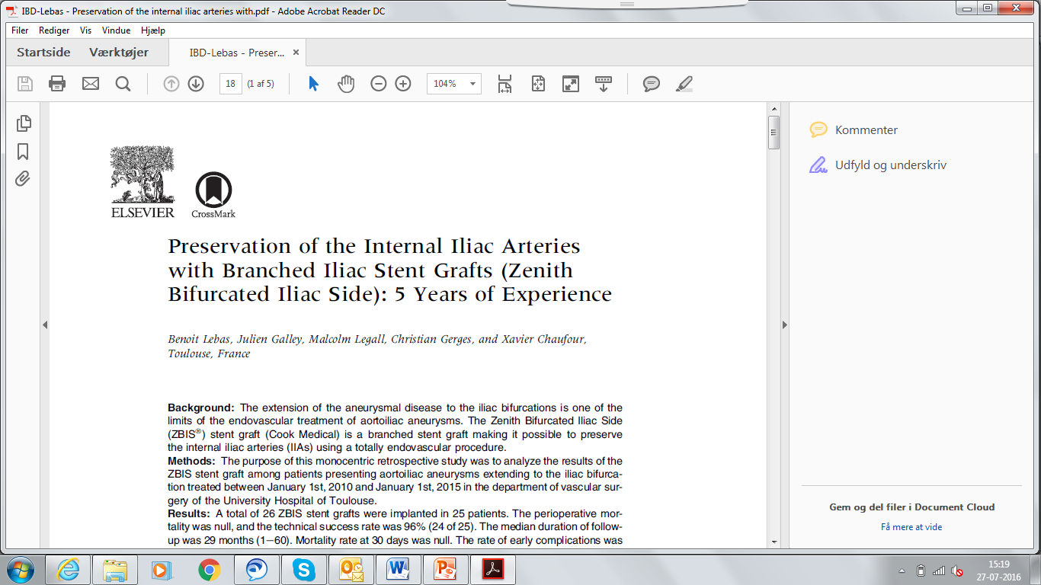
(Ann Vasc Surg. 2016 Mar 4. pii: S0890-5096(16)30079-6. doi: 10.1016)
The ZBIS stent graft makes it possible to exclude aortoiliac aneurysms by endovascular route, whereas preserving the IIA with satisfatory results in the short and medium term.
Technical success rate 96%
Mean FU 29 months
Mortality rate at 30 days 0 %
Rate of early complications 4%

Slide 16
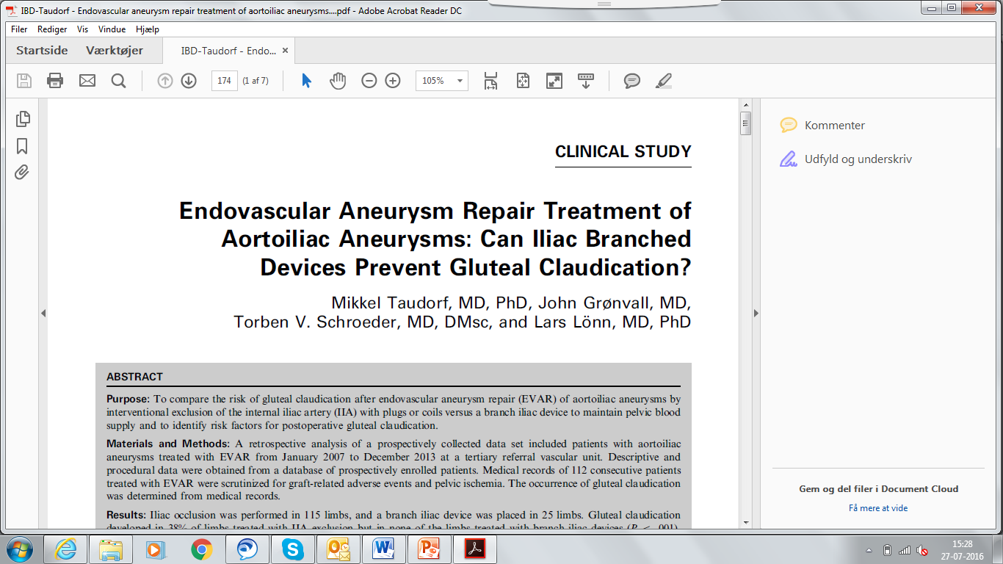
(J. Vasc Interv Radiol 2016 27(2) 174)
To compare the risk of gluteal claudication after endovascular aneurysm repair (EVAR) of aortoiliac aneurysms by interventional exclusion of the internal iliac artery (IIA) with plugs or coils versus a branch iliac device to maintain pelvic blood supply
Iliac occlusion in 115 limbs vs 25 limbs with IBD
Gluteal claudication developed in 38% of limbs treated with IIA exclusion but in none of the limbs treated with branch iliac devices
Procedure time, fluoroscopy time and use of contrast did not differ between the two groups

Slide 17
Conclusion: Physicians Benefits
Versus open surgery and embolization of hypogastric arteries, Zenith®Branch
Procedure time no longer than coiling and over-stenting
No additional access needed than for normal procedure (in opposite to sandwich technique)
Low secondary intervention rate
Preserves collateral bloodflow to the spinal cord if patient further requires thoraco-abdominal endovascular treatment

Slide 18
Personal Experience
Case study:
Indications
Percutaneous or cut down
Male/female
Disease state
Pre-op
OR
Post-op/follow up
Etc.
Example:
Patient 1
75 y/o male
Life long smoker
Pre-op scan of TAA
Post-op image
Etc.
(Encourage physicians to use video of device deploying)

